Slide 1
Team Structure

Slide 2
Team Structure
Team structure addresses organisation of the individual project teams.
Threr are three types of team structure which are as follows:
1.Chief programmer
2. Democratic
3. The mixed control team organisations
Although several other variations to these structures are possible.
Projects of specific complexities and sizes often require specific team structures for efficient working.

Slide 3
Chief programmer team
In this team organisation, a senior engineer provides the technical leadership and is designated the chief programmer.
The chief programmer partitions the task into many smaller tasks and assigns them to the team members.
He also verifies and integrates the products developed by different team members.
The structure of the chief programmer team is shown in following figure.
The chief programmer provides an authority, and this structure is arguably more efficient than the democratic team for well-understood problems.

Slide 4
Chief programmer team
However, the chief programmer team leads to lower team morale, since the team members work under the constant supervision of the chief programmer.
This also inhibits their original thinking.
The chief programmer team is subject to single point failure since too much responsibility and authority is assigned to the chief programmer.
That is, a project might suffer severely, if the chief programmer either leaves the organisation or becomes unavailable for some other reasons.

Slide 5
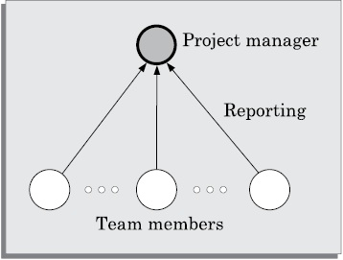
Chief programmer team structure.

Slide 6
Chief programmer team
In a summary , we can tell that
The chief programmer team is probably the most efficient way of completing simple and small projects since the chief programmer can quickly work out a satisfactory design and ask the programmers to code different modules of his designsolution.

Slide 7
The types of projects for which the chief programmer team organisation would be suitable?
Suppose an organisation has successfully completed many simple MIS projects.
Then, for a similar MIS project, chief programmer team structure can be adopted.
The chief programmer team structure works well when the task is within the intellectual grasp of a single individual.
However, even for simple and well- understood problems, an organisation must be selective in adopting the chief programmer structure.
The chief programmer team structure should not be used unless the importance of early completion outweighs other factors such as team morale, personal developments, etc.

Slide 8
Democratic team
The democratic team structure, as the name implies, does not enforce any formal team hierarchy as shown in following figure(Slide-9).
Typically, a manager provides the administrative leadership.
At different times, different members of the group provide technical leadership.
In a democratic organisation, the team members have higher morale and job satisfaction.
Consequently, it suffers from less manpower turnover.

Slide 9
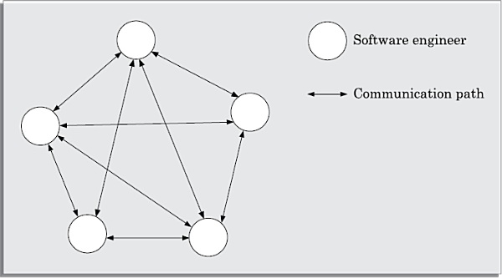
Fig.:Democratic team structure.

Slide 10
Democratic team structure.
Though the democratic teams are less productive compared to the chief programmer team
The democratic team structure is appropriate for less understood problems.
Since a group of developers can invent better solutions than a single individual as in a chief programmer team.
A democratic team structure is suitable for research-oriented projects requiring less than five or six developers.
For large sized projects, a pure democratic organisation tends to become chaotic.

Slide 11
Democratic team structure.
The democratic team organisation encourages egoless programming as programmers can share and review each other’s work.
To appreciate the concept of egoless programming, we need to understand the concept of ego from a psychological perspective.
Most of you might have heard about temperamental artists who take much pride in whatever they create.
Ordinarily, the human psychology makes an individual take pride in everything he creates using original thinking.
Software development requires original thinking too, although of a different type.
The human psychology makes one emotionally involved with his creation and hinders him from objective examination of his creations.

Slide 12
Democratic team structure.
Just like temperamental artists, programmers find it extremely difficult to locate bugs in their own programs or flaws in their own design.
Therefore, the best way to find problems in a design or code is to have someone review it.
Often, having to explain one’s program to someone else gives a person enough objectivity to find out what might have gone wrong.
This observation is the basic idea behind code walk throughs.
An application of this, is to encourage a democratic teams to think that the design, code, and other deliverables to belong to the entire group.

Slide 13
Democratic team structure.
This is called egoless programming because it tries to avoid having programmers invest much ego in the development activity they do in a democratic set up.
Disadvantage
However, a democratic team structure has one disadvantage—the team members may waste a lot time arguing about trivial points due to the lack of any authority in the team to resolve the debates.

Slide 14
Mixed control team organisation
The mixed control team organisation, as the name implies, draws upon the ideas from both the democratic organisation and the chief-programmer organisation.
The mixed control team organisation is shown pictorially in following figure.
This team organisation incorporates both hierarchical reporting and democratic set up.
In following , figure , the communication paths are shown as dashed lines and the reporting structure is shown using solid arrows.

Slide 15
Mixed control team organisation
The mixed control team organisation is suitable for large team sizes.
The democratic arrangement at the senior developers level is used to decompose the problem into small parts.
Each democratic setup at the programmer level attempts solution to a single part.
Thus, this team organisation is eminently suited to handle large and complex programs.
This team structure is extremely popular and is being used in many software development companies.

Slide 16
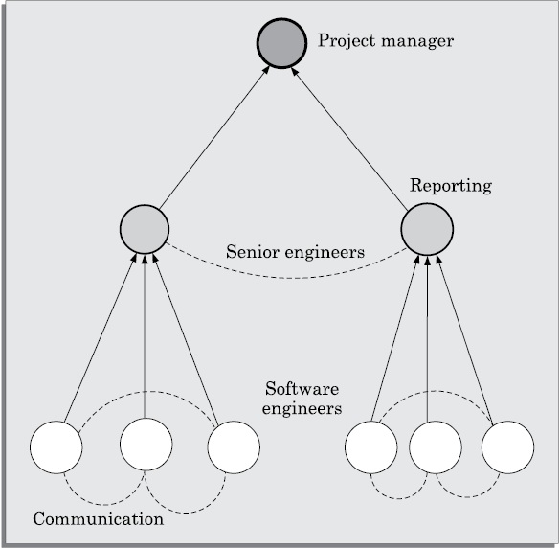
Figure:Mixed team structure

Slide 17
Any Question?

Slide 18
Thank You

